Slide 1
Chapter 20: Electrochemistry
Dr. Aimée Tomlinson
Chem
1212

Slide 2
Section 20.1
Oxidation States &
Oxidation-Reduction Reactions

Slide 3
Oxidation Numbers
Charge an atom will take in order to get to its nearest noble gas thereby forming an octet
Metals will loose electrons
Nonmetals will gain electrons
Metalloids can do either one
Typical Oxidation values
  H is +1
  O is -2
  Alkali metals (Li to Fr) are +1
  Halogens (F to I) are -1
  Alkaline metals (Be to Ra) are +2

Slide 4

Reduction/Oxidation
Reduction
  Occurs when electrons are gained
  Typically done by a cation or a nonmetal
  Is performed by the oxidizing agent (called such as it takes up the electrons lost from the reducing agent)
Oxidation
  Occurs when electrons are lost
  Typically done by a anion or a metal
  Is performed by the reducing agent (called such as it gives up the electrons to the oxidizing agent)
X 2

Slide 5
Section 20.2
Balancing Redox Equations
My methodology

Slide 6
Redox Balancing Example I
Balance the following in acidic conditions:

Slide 7
Redox Balancing Example II
Balance the following in basic conditions:
X 3

Slide 8
Section 20.3
Voltaic Cells

Slide 9
Electrochemistry
The branch of that examines the connection between chemical and electrical energy

Slide 10
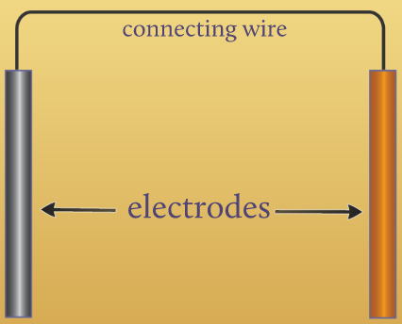
Galvanic or Voltaic Cell
Defn: a device in which electron transfer is forced to take place thru an external pathway rather than directly between reactants
There are several components which compose this cell:
1. electrodes: metal wires or plates connected using a connecting wire

Slide 11
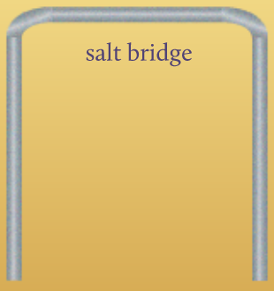
Galvanic or Voltaic Cell
Defn: a device in which electron transfer is forced to take place thru an external pathway rather than directly between reactants
There are several components which compose this cell:
Electrodes
Salt Bridge: U-shaped tube filled with inert salt gel
- completes the circuit
- allows electrons to flow btwn the 2 cells

Slide 12
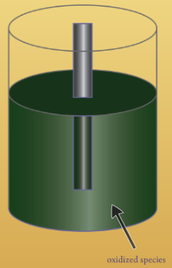
Galvanic or Voltaic Cell
Defn: a device in which electron transfer is forced to take place thru an external pathway rather than directly between reactants
There are several components which compose this cell:
Electrodes
Salt Bridge
Anode: half-cell where oxidation takes place

Slide 13
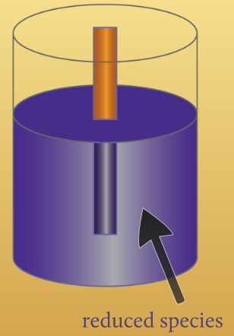
Galvanic or Voltaic Cell
Defn: a device in which electron transfer is forced to take place thru an external pathway rather than directly between reactants
There are several components which compose this cell:
Electrodes
Salt Bridge
Anode
Cathode: half-cell where reduction takes place

Slide 14
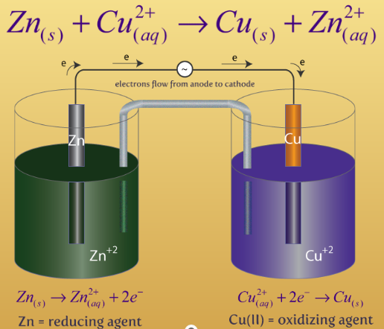
Galvanic or Voltaic Cell
Defn: a device in which electron transfer is forced to take place thru an external pathway rather than directly between reactants
There are several components which compose this cell:
Electrodes
Salt Bridge
Anode
Cathode

Slide 15
Voltaic Cell Example
A voltaic cell with a basic electrolyte is based on the oxidation of Cd(s) to Cd(OH)2(s) and the reduction of MnO4-(aq) to MnO2(s). Write the half-reactions, the balanced reaction and draw a diagram of the cell.

Slide 16
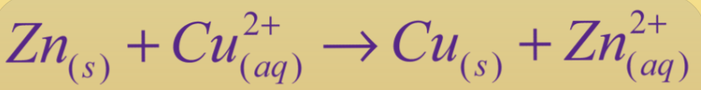
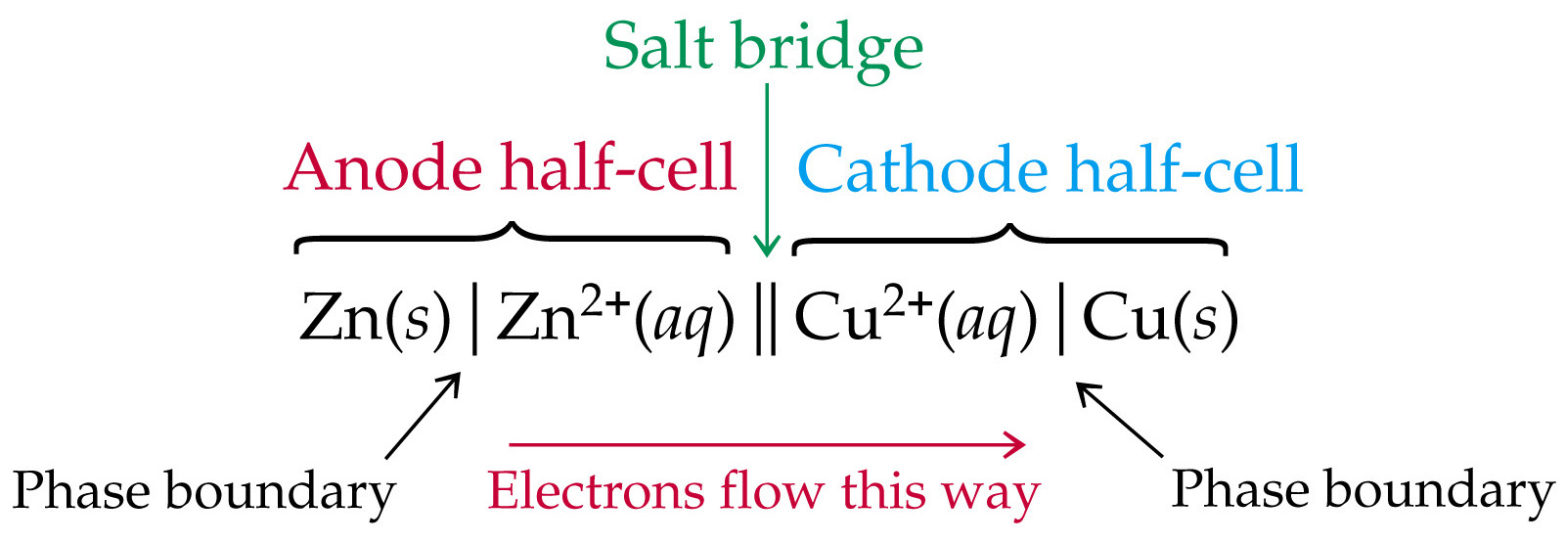
The Shorthand Notation

Slide 17

Applied to Example

Slide 18
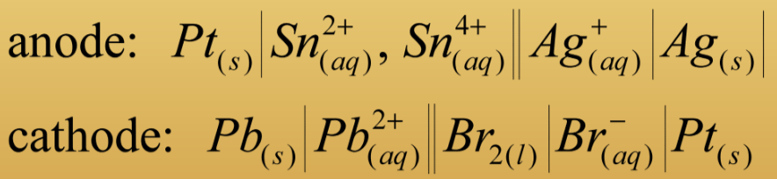
The use of Pt
If one of the ½ reactions is missing a metal electrode, we insert an inert metal to complete the circuit – usually we use Pt
X 3

Slide 19
Section 20.4
Cell Potential Under Standard Conditions

Slide 20
Cell Potential, E_{cell}
Voltage between electrodes of a voltaic cell
Aka electromotive force or emf
Always possesses units of volts, V
This force is related to the amount of work the cell can perform
Because we are talking about electron flow we need to discuss charge
  The SI unit for electrical charge is Coulomb, C (1e- = 1.602 x 10⁻¹⁹ C)
  This is directed related to the moles of electrons(n) using Faraday’s constant(F) or C = nF where 9.65x10⁴ C/mol

Slide 21
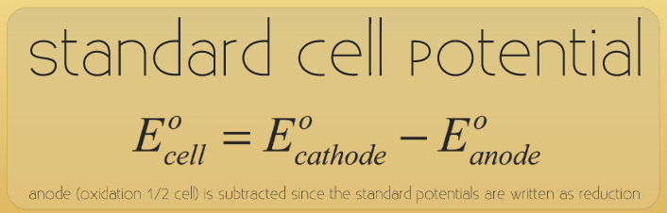
Standard Reduction Potential, E⁰
Defn: the emf of a half-rxn written in its reduction form where all
the species are in their standard states with their concentrations or partial pressures being 1M or 1 bar.
The key word here is “reduction” so recall the anode is where oxidation takes place which is the opposite both in process and sign to reduction – hence the negative in the equation

Slide 22
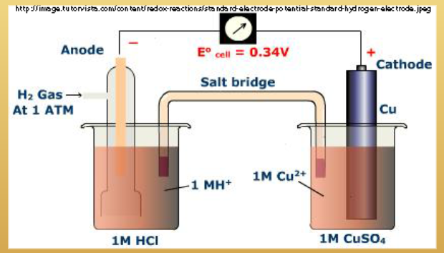
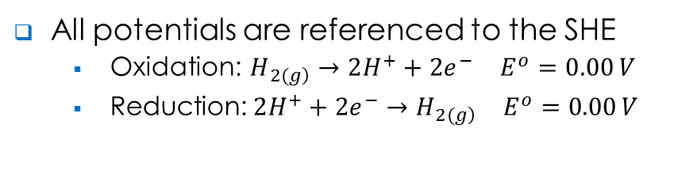
Standard Hydrogen Electrode, S.H.E.
All potentials are referenced to the SHE
  Oxidation: $H_{\left.2(g\right)}→2H^{+}+2e^{−} E^{o}=0.00 V$
  Reduction:$2H^{+}+2e^{−}→H_{\left.2(g\right)} E^{o}=0.00 V$

Slide 23
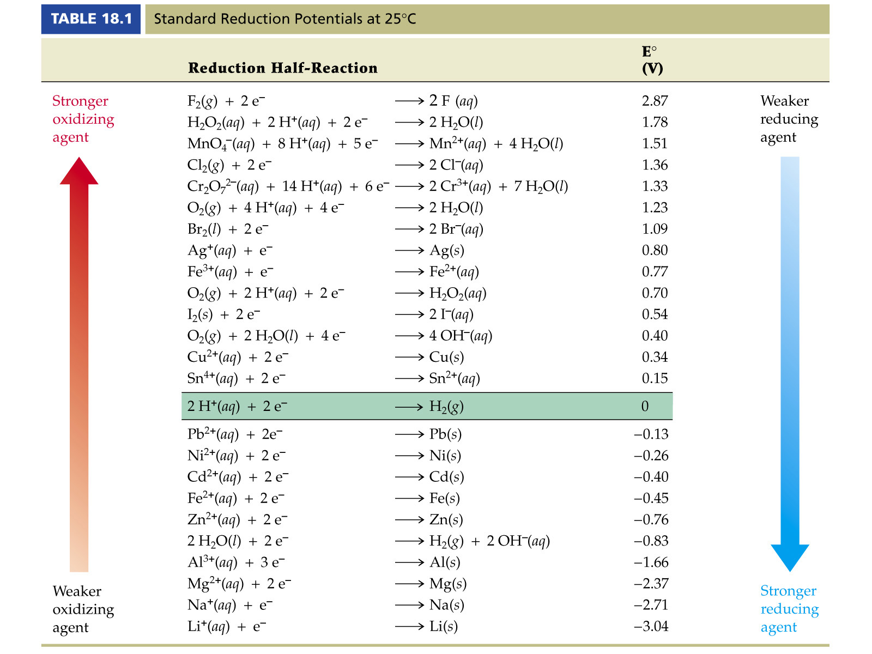
Oxidation/Reduction Strength
Strong oxidizing agents are more willing to take e⁻’s (F)
  They are very EN and have high EA
  Standard cell potential is positive
Strong reducing agents are more willing to lose e⁻’s (Li)
  They are less EN and have low EA
  Standard cell potential is negative

Slide 24
E_{cell} Example II
Given the information below determine the voltage and write the balanced equation of the following voltaic cell.
X 3

Slide 25
Section 20.5
Free Energy &
Redox Potentials

Slide 26
Free Energy & E_{cell}
Negative because the cell is performing work on the surroundings
  When ΔG < 0 the system is spontaneous
  when ΔG > 0 the system is nonspontaneous
Therefore if ΔG < 0 and E_{cell} > 0 we have a spontaneous reaction
Conversion between them is C*V = 1 J
  Recall C = nF where n = number of electrons
  So when we have to balance redox equations using coefficients we are multiplying the n in the C part of this equation but leaving the V part untouched
  Hence we never multiply voltages when we add half-reactions together

Slide 27
Voltaic vs Electrolytic Cells
Defn of electrolytic cell: it is a cell that requires an external source to cause electrons to flow
Voltaic Cell
Electrolytic Cell
Always spontaneous
ΔG < 0 & E > 0
Always nonspontaneous
ΔG > 0 & E < 0

Slide 28
E_{cell} Example I
Calculate the emf & determine if the reactions below are spontaneous.
X 2

Slide 29
Section 20.6
Cell Potential Under Nonstandard Conditions

Slide 30
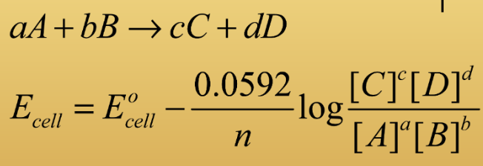
The Nernst Equation

Slide 31
Nernst Examples
Calculate the E_{cell} at 298K for the cell based on the following:
[Fe³⁺] = [Cr²⁺] = 1.50x10⁻³M, [Fe²⁺] = [Cr³⁺] = 2.5x10⁻⁴M

Slide 32
Sections 20.7 – 20.9
Skip!!!!!

